Slide 1
Introduction to Artificial Intelligence
Dr. Ajees A P
Dept of Computer Science
CUSAT

Slide 2
Artificial Intelligence
Artificial Intelligence is composed of two words Artificial and Intelligence
What is the meaning of the word Artificial?
"man-made"
produced by human beings rather than occurring naturally

Slide 3
Intelligence
What is intelligence?
The ability to acquire and apply knowledge and skills.
What are different types of intelligence?
Logical, linguistic, musical, spatial, inter-personal, etc.
When we say a person is intelligent?
When he can handle new situations and solve problems
i.e. he should have a good thinking power
What is Artificial Intelligence?

Slide 4
Artificial Intelligence
Hence AI means "a man-made thinking power.“

Slide 5
Some Definitions of AI
Artificial Intelligence (AI) is an area of computer science that emphasizes the creation of intelligent machines that work and react like humans.
Artificial intelligence (AI) refers to the simulation of human intelligence in machines.
The capability of a machine to imitate the intelligent human behavior.

Slide 6
Some Definitions of AI
AI is the science and engineering of making intelligent machines, especially intelligent computer programs.
Artificial Intelligence exists when a machine can have human based skills such as learning, reasoning, and solving problems

Slide 7
Advantages of Artificial Intelligence vs Human Intelligence
Speed of execution – While one doctor can make a diagnosis in ~10 minutes, AI system can make a million for the same time.
Less Biased – They do not involve Biased opinions on decision making process
Operational Ability – They do not expect halt in their work due to saturation
Accuracy – Preciseness of the output obviously increases

Slide 8
How do we measure if Artificial Intelligence is acting like a human?
Turing Test
The Cognitive Modelling Approach
The Law of Thought Approach
The Rational Agent Approach

Slide 9
Turing test in AI
The Turing Test is a method that is used to test the intelligence of a machine through specific inquiries.
It tries to test whether a machine can think like a human.
It uses three subjects in its performance, i.e., a human, a machine, and an interrogator.

Slide 10
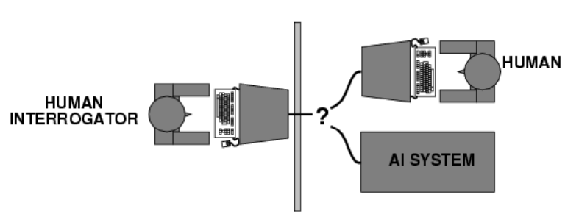
Acting humanly: Turing Test
The computer passes the test if a human interrogator after posing some written questions, cannot tell whether the written responses from a person or not.

Slide 11
Acting humanly: Turing Test
To pass the Turing Test the computer would need to possess the following capabilities:
Natural language processing to enable it to communicate successfully in English
Knowledge representation to store what it knows or hears
Automated reasoning to use the stored information to answer questions and to draw new conclusions
Machine learning to adapt to new circumstances and to detect and extrapolate patterns
Computer vision to perceive objects
Robotics to manipulate objects and move about

Slide 12
Turing Test in Artificial Intelligence
The basis of the Turing Test is that the Artificial Intelligence entity should be able to hold a conversation with a human agent
To achieve this, AI needs to possess:
Natural Language Processing to communicate successfully.
Knowledge Representation to act as its memory.
Automated Reasoning to use the stored information to answer questions and draw new conclusions.
Machine Learning to detect patterns and adapt to new circumstances.

Slide 13
Why is AI important to the future?
Artificial intelligence is impacting the future of virtually every industry and every human being.
Artificial intelligence has acted as the main driver of emerging technologies like big data, robotics and IoT.

Slide 14
What are the Types of Artificial Intelligence?
Artificial Narrow Intelligence (ANI)
Artificial General Intelligence (AGI)
Artificial Super Intelligence (ASI)

Slide 15
What is Artificial Narrow Intelligence (ANI)?
This is the most common form of AI that you’d find in the market now – Weak AI
These Artificial Intelligence systems are designed to solve one single problem and would be able to execute a single task really well. By definition, they have narrow capabilities, like recommending a product for an e-commerce user or predicting the weather
They’re able to come close to human functioning in very specific contexts, and even surpass them in many instances, but only excelling in very controlled environments with a limited set of parameters.

Slide 16
What is Artificial General Intelligence (AGI)?
AGI is still a theoretical concept – Strong AI
It’s defined as AI which has a human-level of cognitive function, across a wide variety of domains such as language processing, image processing, computational functioning and reasoning and so on. We’re still a long way away from building an AGI system
An AGI system would need to comprise of thousands of Artificial Narrow Intelligence systems working in tandem, communicating with each other to mimic human reasoning
Even with the most advanced computing systems and infrastructures, such as Fujitsu’s K or IBM’s Watson, it has taken them 40 minutes to simulate a single second of neuronal activity
This speaks to both the immense complexity and interconnectedness of the human brain, and to the magnitude of the challenge of building an AGI with our current resources.

Slide 17
What is Artificial Super Intelligence (ASI)?
We’re almost entering into science-fiction territory here, but ASI is seen as the logical progression from AGI – Strong AI
An Artificial Super Intelligence (ASI) system would be able to surpass all human capabilities
This would include decision making, taking rational decisions, and even includes things like making better art and building emotional relationships

Slide 18
(Contd..)
Once we achieve Artificial General Intelligence, AI systems would rapidly be able to improve their capabilities and advance into realms that we might not even have dreamed of
While the gap between AGI and ASI would be relatively narrow (some say as little as a nanosecond, because that’s how fast Artificial Intelligence would learn) the long journey ahead of us towards AGI itself makes this seem like a concept that lays far into the future.

Slide 19
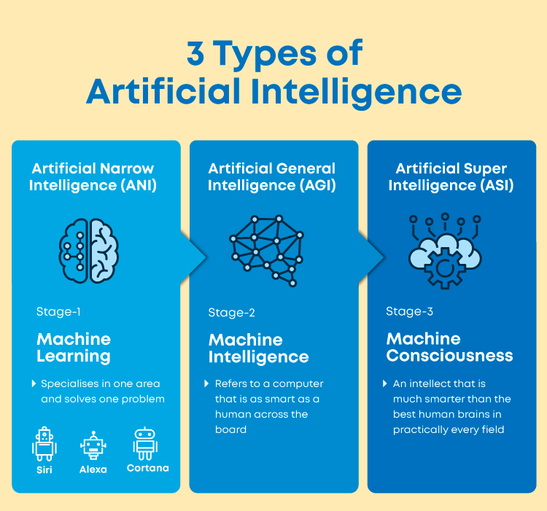

Slide 20
Types of artificial intelligence—weak AI vs. strong AI
Weak AI—also called Narrow AI or Artificial Narrow Intelligence (ANI)—is AI trained and focused to perform specific tasks
Weak AI drives most of the AI that surrounds us today. ‘Narrow’ might be a more accurate descriptor for this type of AI as it is anything but weak; it enables some very robust applications, such as Apple's Siri, Amazon's Alexa, IBM Watson, and autonomous vehicles.

Slide 21
Strong AI
Made up of Artificial General Intelligence (AGI) and Artificial Super Intelligence (ASI). Artificial general intelligence (AGI), or general AI, is a theoretical form of AI where a machine would have an intelligence equaled to humans; it would have a self-aware consciousness that has the ability to solve problems, learn, and plan for the future
Artificial Super Intelligence (ASI)—also known as superintelligence—would surpass the intelligence and ability of the human brain
While strong AI is still entirely theoretical with no practical examples in use today, that doesn't mean AI researchers aren't also exploring its development. In the meantime, the best examples of ASI might be from science fiction, such as HAL, the superhuman,etc.

Slide 22
Difference between Augmentation and AI
Artificial Intelligence | Augmented Intelligence
AI replaces humans and operates with high accuracy. | Augmentation does not replace people but creates systems that help in manufacturing.
Replaces human decision making | Augments human decision making
Robots/Industrial IoT: Robots will replace all humans on the factory floor. | Robots/Industrial IoT: Collaborative robots work along with humans to handle tasks that are hard and repetitive.
Real-Time Applications of AI in Customer Success 1. Automated Customer Support and Chatbots 2. Virtual Assistants Automated Workflows | Real-Time Applications of IA in Customer Success 1. IA-enabled customer analytics 2. Discover high risk/high potential customers 3. Forecasts Sales

Slide 23
WHAT ARE EXAMPLES OF ARTIFICIAL INTELLIGENCE?
Siri, Alexa and other smart assistants
Self-driving cars
Robo-advisors
Conversational bots
Email spam filters
Netflix's recommendations

Slide 24
What are the BENEFITS of Artificial Intelligence?
Automation
Smart Decision Making
Enhanced Customer Experience
Medical Advances
Research and Data Analysis
Solving Complex Problems
Business Continuity
Managing Repetitive Tasks

Slide 25
What are the advantages of AI?
AI drives down the time taken to perform a task
AI enables the execution of complex tasks without significant cost outlays
AI operates 24x7 without interruption or breaks and has no downtime
AI augments the capabilities of differently abled individuals.

Slide 26
What are the disadvantages of AI?
High cost of implementation.
Setting up AI-based machines, computers, etc.
Can't replace humans.
Doesn't improve with experience.
Lacks creativity.
Risk of unemployment.

Slide 27
Is artificial intelligence a good career?
As an AI aspirant, you have ample of job opportunities in this field.
Some AI job includes machine learning engineer, data scientist, business intelligence developer, research scientists, and AI engineer.
Artificial intelligence engineer is one of the most prominent job roles in the AI industry today.

